Slide 1
جامعة ديالى
كلية الهندسة
قسم الهندسة الكيمياوية
Unit Operations
Lecturer
Dr Salah N. Farhan

Slide 2
Mechanical Separation

Slide 3
Mixtures and Pure Substances:-
A mixture contains two or more constituent substances which are not chemically combined together, and this mixture retains the properties of its constituents, for examples; air, seawater, alloys like brass, bronze and steel.
Pure substances:-
Pure substance is a single substance not mixed with anything else, most things around us are not pure substances. Eg. Gold used in jewellery. So purification processes need to be used to obtain pure substances.

Slide 4
Separation Techniques:-
Separation techniques refers to the physical methods that can be used to separate the constituents of mixtures.
Sometimes, a combination of separation techniques will be used to obtain pure substances.
Separation techniques are essentially methods of purification.
Accomplished using different characteristic properties, such as density, boiling point, melting point, solubility, proportion of solid to liquid in mixture, viscosity,.. etc.

Slide 5
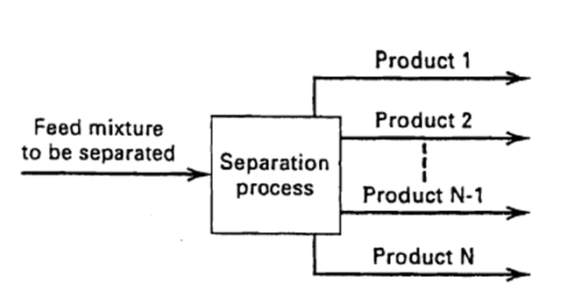
Types of Separation Techniques:-
Filtration, mechanical separation, Evaporation, floatation, centrifugation, simple distillation, fractional distillation, crystallization, chromatography.
The mixture can be a combination of any two or more states: solid-solid, solid-liquid, solid-gas, liquid-liquid, liquid-gas, gas-gas, solid-liquid-gas mixture, etc.

Slide 6
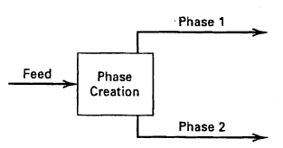
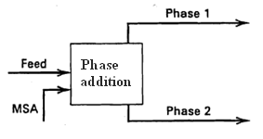
Separation Process Mechanisms
Phase creation
Phase addition

Slide 7
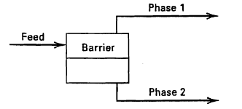
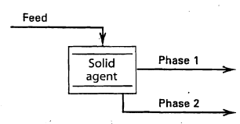
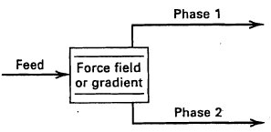
Barrier
Solid agent
External field

Slide 8
How separation is carried out?
In order to affect a separation, separating agents are needed in the form of either:
Energy input (heat, electricity, magnetism,)
Withdrawal of energy ( cooling, freezing)
Medium (filter, membrane, screens)
May be any phase as well as any chemical

Slide 9
Separation Mechanism | Separation Operation | Initial / Feed Phase | Created or Added Phase
Phase Creation Phase Addition | Distillation | Liquid and/or Vapor | Liquid + Vapor
 | Absorption | Vapor | Liquid
 | Stripping | Liquid | Vapor
 | Condensation | Vapor and or liquid | Liquid or Vapor
 | Liquid-Liquid Extraction | Liquid | Liquid
 | Drying | Liquid + Solid | Vapor
Phase Creation Phase Addition | Distillation | Liquid and/or Vapor | Liquid + Vapor
 | Absorption | Vapor | Liquid
 | Stripping | Liquid | Vapor
 | Condensation | Vapor and or liquid | Liquid or Vapor
 | Liquid-Liquid Extraction | Liquid | Liquid
 | Drying | Liquid + Solid | Vapor

Slide 10
Separation Processing:
Mass Transfer Operations:
Mechanical Separations:
Based on transfer of material between phases
Based on physical differences, such as density, size, or shape
Applicable to
Homogeneous Solutions
Applicable to
Heterogeneous Mixtures
Absorption, drying,
distillation, solvent extraction
Sedimentation, Filtration
Flotation, Clarification

Slide 11
Separation Processing:
Mass Transfer Operations:
Mechanical Separations:
Distillation
Absorption
Stripping
Adsorption
Liquid-Liquid Extraction
Drying
Evaporation
Crystallization
Leaching
Ion Exchange
Filtration
Ultra-filtration
Sedimentation
Centrifugal Separation
Flotation
Electrostatic Precipitation
Jigging
Tabling
Sonic Agglomeration
Membrane Separation

Slide 12
Classification of Separation processes:-
The classification can be based on the means of separation;
Mechanical Processes
Chemical processes
Key operations in Chemical Plant:-
● Chemical Reactions
● Separation of chemicals
●Separation of phases

Slide 13
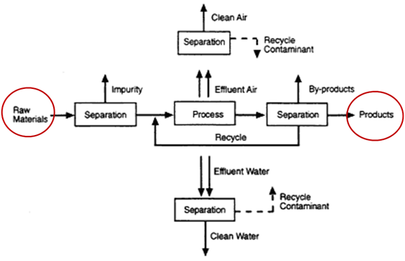

Slide 14
Advantages
Relatively less Energy Requirements
Ease of Operation
Ease of Maintenance
No special Feed pretreatment required
Disadvantages
Not applicable for separating Components in homogeneous phase
Not versatile i.e. in same state may be one element can be separated and other don’t.
Applicable to low flow rates

Slide 15
Classification:-
On the basis of characteristics
    Depending on the difference in size or shape
    Depending on the difference in phase density
    Depending on fluid and particle mechanics
    Depending on surface, electrical or magnetic properties
On the basis of phases involved
    S-S
    L-L
    G-L
    L-G
    S-L
    L-S
    S-G

Slide 16
Our focus will be on :-
Solid – Solid Separation
Solid – Liquid Separation
Solid – Gas Separation
Solid – Solid Separation
Objective – to separate the mixture of solids into
two or more fractions
Dry basis
    Screening
    Electrostatic
    magnetic
Wet basis
    Classification

Slide 17
Solid – Liquid Separation
Objective – to separate the solids and liquid from each other
  Filtration
  Sedimentation – gravitational settling
  Centrifugal separators
Solid – Gas Separation
Objective – to separate the solids from gas
  Filtration
  Gravitational settling
  Centrifugation

Slide 18
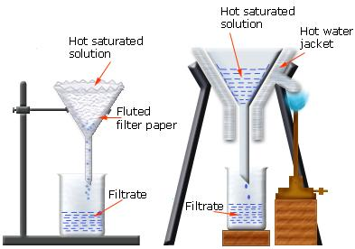
Filtration
Filtration is a mechanical or physical operation which is used for the separation of solids from fluids by interposing a medium through which only the fluid can pass.

Slide 19
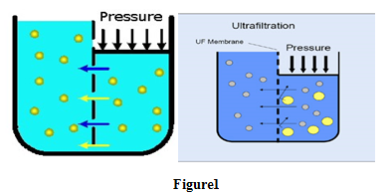
Ultra-filtration (UF) is a variety of membrane filtration in which hydrostatic pressure forces a liquid against a semi permeable membrane. Suspended solids and solutes of high molecular weight are retained, while water and low molecular weight solutes pass through the membrane.

Slide 20
Factor affected on filtration
Pressure drop ∆P(from feed to far side of the filter medium), area of filtering surface, Viscosity of filtrate (µ), Resistance of filter cake (α ), Resistance of filter medium ( R_{m}), Properties of slurry.
Types of filtration
1. Surface filters ;
2. Depth filters

Slide 21
1. Surface filters
Used for cake filtration in which the solids are deposited in the form of a cake on the up-stream side of a relatively thin filter medium. Then the filtrate can be detached from medium.
Figure2. Mechanism of cake filtration

Slide 22
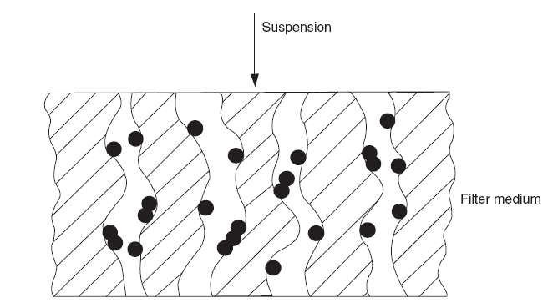
2. Depth filters
Used for deep bed filtration in which particle deposition takes place inside the medium and cake deposition on the surface is undesirable.
Figure 3. Mechanism of deep bed filtration

Slide 23
The fluid passes through the filter medium, which offers resistance to its passage, under the influence of a force which is the pressure differential across the filter. The rate of filtration can be expressed generally as
Rate of filtration= driving force/resistance
Initial stage of filtration is important due to:-
Rate of flow is greatest at beginning, since resistance is minimum.
High initial rate of filtration may results in plugging of pores.
Orientation of particles in initial layer can effect cake structure.

Slide 24
Theory of Filtration
It is depend on Carmen-Kozeny Equation:-
K:- Kozeny constant=5
For Filtration:-
For incompressible cake, ε could taken constant.
were 1/r=specific resistance.

Slide 25

Where:-
V is volume of filtrate passed in time t, A is total cross-sectional area of filter cake, u is superficial velocity of filtrate(m/s), l is cake thickness(m), S is specific surface area of particles(m²/ m³), ε is porosity, µ is viscosity of filtrate(Pa.s), ∆p is applied pressure difference(N/ m²), ρ is fluid density(kg/m³), and ρ_{s} is solid density(kg/m³).

Slide 26
where
is the specific resistance (m⁻²)
Rate of filtration= driving force/resistance
-(ΔP) or Pressure drop
Filter cake (α)
Filter medium (R_{m})
Viscosity (μ)
Filter cake can be divided into two classes:-
(1) Incompressible cakes.
(2) Compressible cakes.

Slide 27
(1) Incompressible cakes:
The resistance to flow of a given volume of cake is not affected either by the pressure difference across the cake or by the rate of deposition of material (i.e. constant ε and S).
(2) Compressible cakes:
Increase of the pressure difference or of the rate of flow causes the formation of a denser cake with a higher resistance.
For incompressible cake the filtration equation becomes
(3)

Slide 28
Relation between thickness of cake and volume of filtrate
Mass balance on solid in slurry and cake:-
Mass of solids in slurry = Mass of solids in filter cake= Vol. of solid *ρ_{S}
Mass of solids in filter cake= [volume of cake – volume of pores]* ρ_{s}
Mass of solids in filter cake
where ρ_{s} is the density of the solids.
Mass of liquid retained in the filter cake
where ρ is the density of the filtrate.
If X is the mass ratio of solids in the original suspension then:

Slide 29
X is the mass ratio of solid in feed slurry, x is mass fraction of solid in feed slurry
And
If υ is the volume of cake deposited by unit volume of filtrate then

Slide 30
Substituting for l in equation 3, we get
Or
Both equation (10) and (11) contains ∆p,dv/dt, or dl/dt

Slide 31
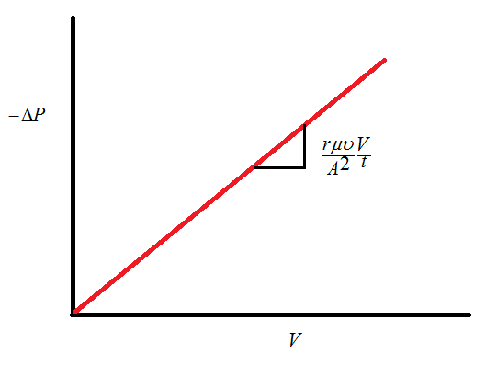
There are two modes of operation:
Filtration at constant rate:
Or
is proportional to V:-

Slide 32
2.Filtration at constant pressure difference
This is the most common mode for filtration. In constant pressure filtration mode:
Equation is useful because it covers a situation that is frequently found in a practical filtration plant.
We could predict the performance of filtration plant on the basis of experimental results.
If a test is carried out using constant pressure, collecting and measuring the filtrate at measured time intervals
Integration of equation12 gives:

Slide 33
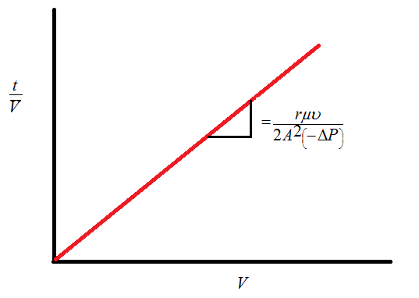
There is linear relation between V² and t
Or
If the integration of equation 12 is performed
between t₁, t and V₁, V we get:

Slide 34
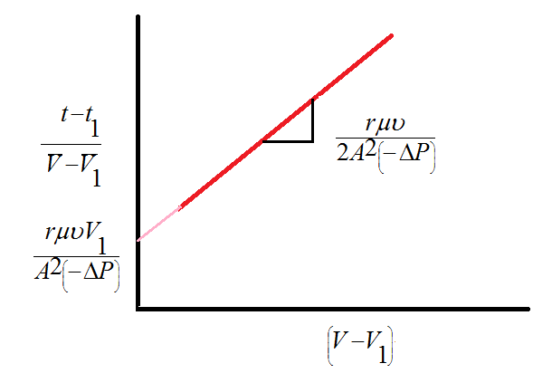
Which is a linear relation between
and
All these relations for pressure drop due to cake resistance only; ignoring effect of cloth.

Slide 35
Flow of filtrate through the cloth and cake combined:-
To consider the filter cloth resistance, we assume that the filter cloth has equivalent cake thickness of l_{e}.
Using equation 3,
and
Or

Slide 36
For constant rate of filtration:
Straight line relationship for constant rate filtration.

Slide 37
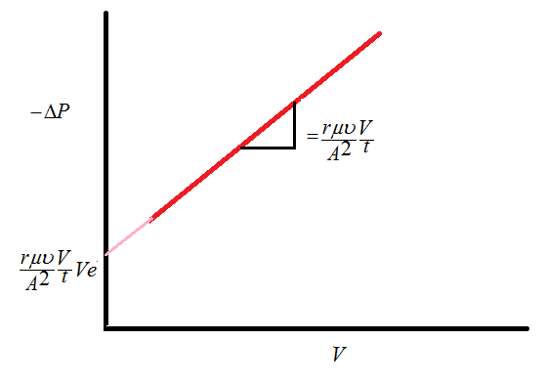

Slide 38
For constant pressure:
Integrating equation (17):-
For constant pressure drop: Integration,
t = t₁, V = V₁ and t = t, V = V gives

Slide 39
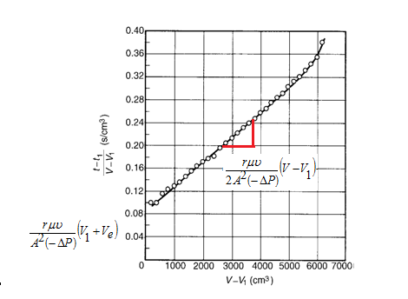
Linear relation between
and V-V₁ as shown in
the figure below. The slope depends on the specific resistance.

Slide 40
Notes:-
In deriving these equations, it is assumed that the cake is uniform and the porosity(ε) is constant, where(ε) depends on the nature of supports (geometry and surface structure), and independence on the rate of deposition of solids.
In incompressible cake, resistance to flow of a given volume of cake is not effected by pressure difference or rate of deposition of solids.
Increasing ∆p or rate of deposition in incompressible cake causes formation of a denser cake with high resistance.

Slide 41
Filter Selection
The criteria in selection the type of the filter is that the most suitable filter for any given operation is the one which will fulfill the requirements at minimum overall cost. The following points should be considered:
The cost of the equipment is closely related to the filtering area.
High pressures mean high filtration rate.
Continuous filters are used for high throughput.
Batch filters, are used particularly if the filter cake has a high resistance.
Ease of discharge of the filter cake in a convenient physical form is an important factor in filter selection.
The most common types of filters are:
Filter presses
Leaf filters
Continuous rotary filters

Slide 42
The most important factors in filter selection are the specific resistance of the filter cake, the quantity to be filtered, and the solids concentration.
Continuous Rotary Filter
Used for high capacity filtration
Does not require any significant manual attention
Preferred if the cake has to be washed
Not used when the specific resistance is high
Not used when efficient washing is required
Not used when only very small quantities of solids are present in the liquid

Slide 43
Filter Press
Used if the specific resistance is high (high positive pressure is required)
Preferred if the solid content is not high (less periodic dismantling)
Leaf Filter
Used when efficient washing is required (thin cake produced)
Used when the risk of channeling during washing is to be reduced
Bed filter
It is a deep bed filtration in which the slurry penetrates the filter and the particles are trapped on the surface of the bed material. This filter is normally used in the water and waste water treatment when the solid concentration is less than 10 g/m³. The beds are formed from granular material of grain size 0.6–1.2 mm in beds 0.6–1.8 m deep.

Slide 44
The following equation may be applied for this filter
Or on integration
Where:
C is the volume concentration of solids in suspension in the filter,C_{o} is the value of C at the surface of the filter,l is the depth of the filter, andλ is the filter coefficient. If u_{c} is the superficial flowrate of the slurry, then the rate of flow of solids through thefilter at depth l is u_{c}C per unit area. Thus the rate of accumulation of solids in a distance dl =

Slide 45
If σ is the volume of solids deposited per unit volume of filter at adepth l, the rate of accumulation may also be expressed as
, thus
Where u_{c} is the superficial flow rate of the slurry, σ is the volume of solids deposited per unit volume of filter at a depth l, (∂σ/∂t) dl, the rate of accumulation. The back wash of bed filter includes a backflow of air followed by water, the flow rate of which may be high enough to give rise to fluidization, with the maximum hydrodynamic shear occurring at a voidage of about 0.7.

Slide 46
The Plate and Frame Filter Press
This filter consists of plates and frames arranged alternately and supported on a pair of rails. The frames are usually square and may be 100 mm–2.5 m across and 10 mm–75 mm thick.

Slide 47
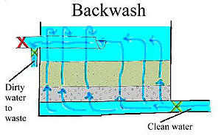
Washing of the filter cake:-
(1) Simple Washing:-
Washing liquid is fed to in through the same channel as the slurry but its velocity near the point of entry is high, erosion of cake occurs.
Rate of Washing= Rate of Filtration

Slide 48
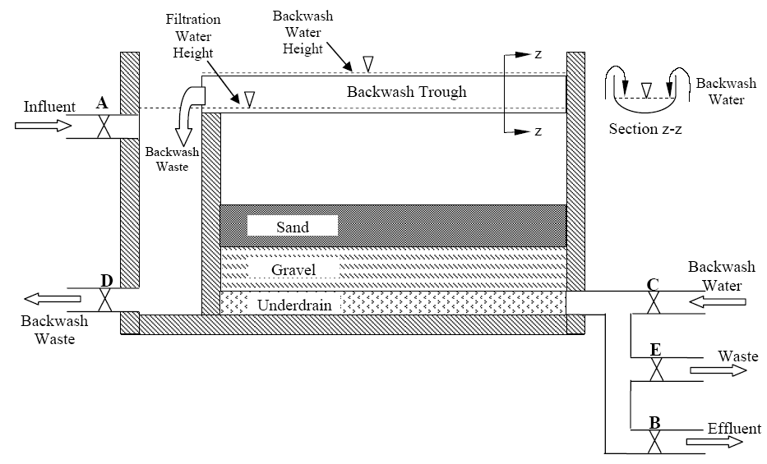
(2) Through Washing:-
Washing liquid is fed to in through separate channel behind the filter cloth on alternate plate known as washing plates.

Slide 49
Equation for Washing of Filter Cakes & Total cycle Time:-
Amount of washing liquid should be sufficient to give the desired washing effect. For constant pressure filtration, using the same pressure in washing as in filtering, final filtering rate is reciprocal:-
V_{f}:- total volume of filtrate for entire period at end of filtration m³
For plate and Frame filter process; washing liquid travels through a cake twice as thick and an area only half as large as in filtering, so predicting washing rate is quarter of the final filtration:-

Slide 50
After washing is completed, additional time is needed to remove the cake, clean filter, reassemble the filter.
Total filter cycle time is sum of filtration time, washing time, plus cleaning time:-

Slide 51
Optimum Time Cycle:-
Or
the time of filtration is
Let be the time of dismantling and assembling the press which is independent of the thickness of cake produced. The total time of a cycle in which a volume V of filtrate is collected is then and the overall rate of filtration is given by:-

Slide 52
Differentiating W with respect to V and equating to zero, we get:
Or
If we neglect the resistance of the cloth, this means that le=0, then B₂ = 0 and
which means that the time needed for mantling and dismantling is the same as that taken for service. In practice, in order to obtain the maximum overall rate of filtration, the filtration time must always be somewhat greater in order to allow for the resistance of the cloth, represented by the term B₂V.

Slide 53
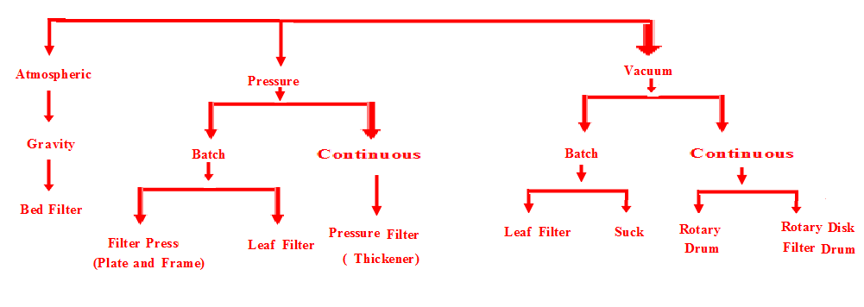
Classification of Filtration Equipments:-
Filter operate above atmospheric on upstream side of filter medium.
Filter operate with atmospheric pressure on upstream side of filter medium.
Filter operate with vacuum pressure on downstream side of filter medium.

Slide 54
Advantages of the filter press
(a) Because of its basic simplicity the filter press is versatile and may be used for a wide range of materials under varying operating conditions of cake thickness and pressure.
(b) Maintenance cost is low.
(c) It provides a large filtering area on a small floor space and few additional associated units are needed.
(d) Most joints are external and leakage is easily detected.
(e) High pressure operation is usually possible.
(f) It is equally suitable whether the cake or the liquid is the main product.
Disadvantages of the filter press
(a) It is intermittent in operation and continual dismantling is apt to cause high wear on the cloths.
(b) Despite the improvements mentioned previously, it is fairly heavy on labor.

Slide 55
Example 1
A laboratory leaf filter has an area of 0.1 m², operates at a constant pressure drop of 400 kPa and produces the following results during a test on filtration of slurry:
Calculate the time required to collect 1.5 m³ of filtrate during filtration of the same slurry at a constant pressure drop of 300 kPa on a similar full-scale filter with and area of 2 m².
Volume of filtrate collected (liter) | 19 | 31 | 41 | 49 | 56 | 63
Time (sec) | 300 | 600 | 900 | 1200 | 1500 | 1800

Slide 56
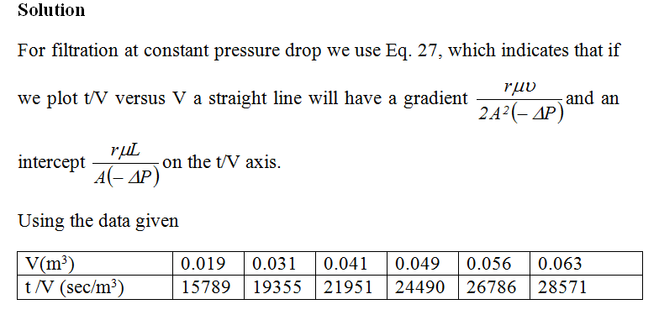
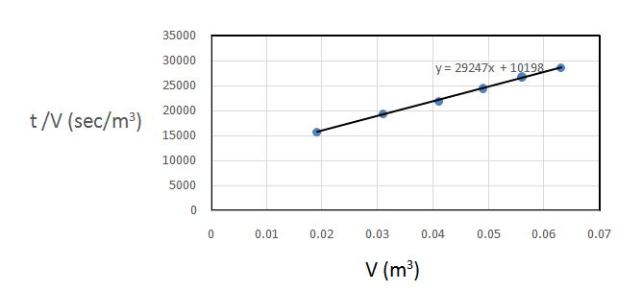

Slide 57
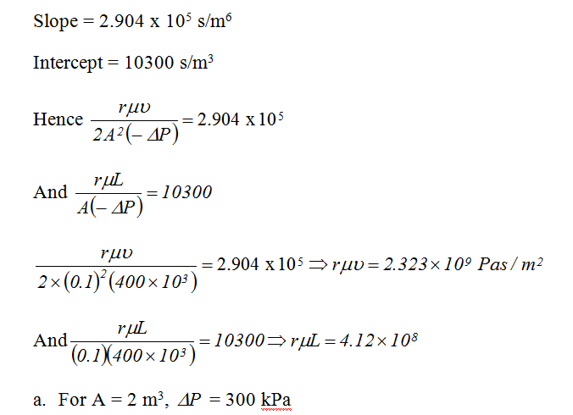

Slide 58
Example 2
A leaf filter has an area of 2 m² and operates at a constant pressure drop of 250 kPa. The following results were obtained during a test with an incompressible cake:
Calculate:
(a) The time required to collect 1200 liter of filtrate at a constant pressure drop of 400 kPa with the same feed slurry.
Volume of filtrate collected (litre) | 280 | 430 | 540 | 680 | 800
Time (min) | 10 | 20 | 30 | 45 | 60
(b) Calculate the rate of passage of filtrate at the end of the filtration in part (a).
(c) The time required to wash the resulting filter cake with 500 liter of water (same properties as the filtrate) at a pressure drop of 200 kPa.

Slide 59
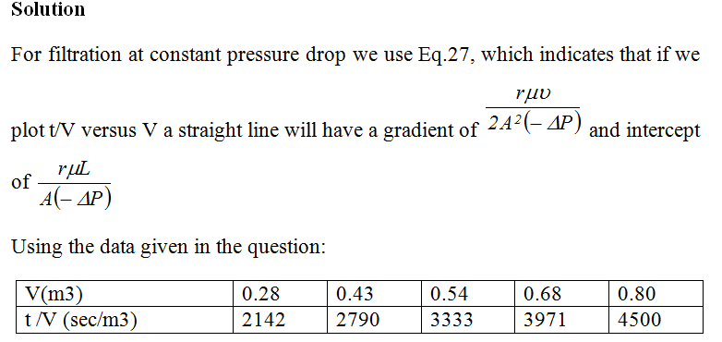
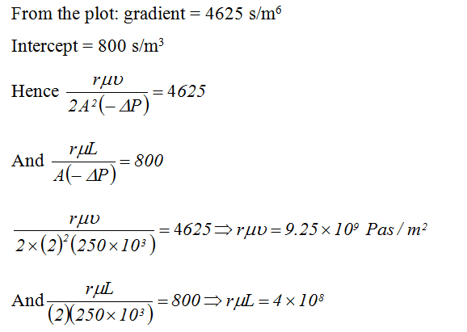

Slide 60
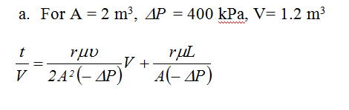
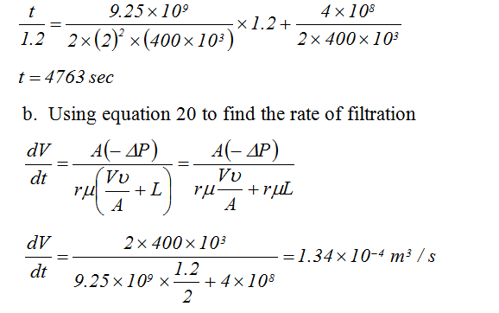

Slide 61
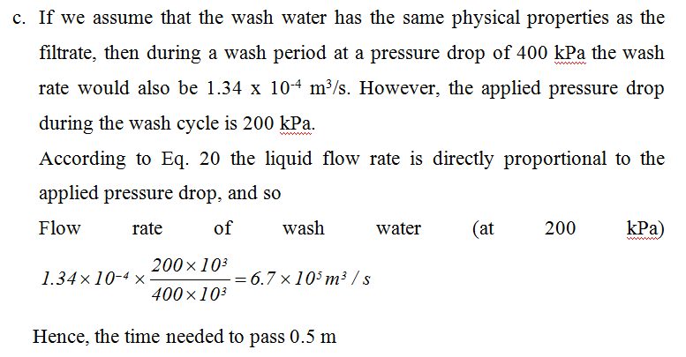

Slide 62
Ex. 3 Constant pressure
Filtration area = 0.01 m² A
Solution density = 1,062 kg/m² ρ
Solution viscosity = 1.6×10⁻³ Pa.s μ
Filtration pressure = 200 kPa ΔP
Solid concentration = 3 kg/m³ Cs
Determine specific filter cake resistance and filter medium resistance
Time (sec) | 0 | 14 | 32 | 55 | 80 | 107
Volume (cm³) | 0 | 400 | 800 | 1200 | 1600 | 2000
solution
Y = aX + C, Y axis = tA/V
X axis = V/A, Slope = μαCs/2ΔP, Y intercept = μR_{m}/ΔP

Slide 63
Time (sec) | Volume (cm³) | Volume (m³) | tA/V | V/A
0 | 0 | 0 | 0 | 0
14 | 400 | 0.0004 | 350 | 0.04
32 | 800 | 0.0008 | 400 | 0.08
55 | 1200 | 0.0012 | 458.33 | 0.12
80 | 1600 | 0.0016 | 500 | 0.16
107 | 2000 | 0.0020 | 535 | 0.20

Slide 65
Ex. 4 Constant rate
A slurry containing 25.7 kg dry solids/m³ of filtrate across the filter medium area 2.15 m² at a constant rate of 0.00118 m³/s. If the pressure drop was observed 4,000 and 8,500 Pa after 150 and 450 seconds of filtration, respectively. The viscosity of filtrate was 0.001 Pa.s
Determine the specific cake resistance and filter medium resistance.

Slide 66
ΔP (Pa)
(1)
t (sec)
(2)
(3)
(4)

Slide 67
ΔP (Pa) | t (sec)
4,000 | 150
8,500 | 450

Slide 69
Example 5:-
Filtration of CuCO₃ slurry in water at 298 k, are reported as bellow at constant pressure of 338 kN/m², filter area of plate and frame is 0.0439 m2 and the slurry concentration was 23.47 kg/m³. Calculate S, ε, r, Ve from experimental data knowing that viscosity is 8.937*10⁻⁴ sec?
Time(sec) | 0 | 4.4 | 9.5 | 16.3 | 24.6 | 34.7 | 46.1 | 59 | 73.6 | 89.4 | 107.3
V*10³ m³ | 0 | 0.498 | 1.000 | 1.501 | 2.000 | 2.418 | 3.002 | 3.506 | 4.004 | 4.502 | 5.009
∆t | 0 | 4.4 | 5.1 | 6.8 | 8.3 | 10.1 | 11.7 | 12.4 | 14.6 | 15.8 | 17.4
∆V *10³ | 0 | 0.498 | 0.502 | 0.501 | 0.499 | 0.480 | 0.504 | 0.504 | 0.498 | 0.498 | 0507
∆t/∆V | 0 | 8830 | 10160 | 13570 | 16630 | 20280 | 22620 | 25590 | 29320 | 31730 | 3510
V=[(V₁+V₂)/2]*10³ | 0 | 0.249 | 0.749 | 1.250 | 1.750 | 2.249 | 2.750 | 3.254 | 3.755 | 4.253 | 4.755

Slide 70
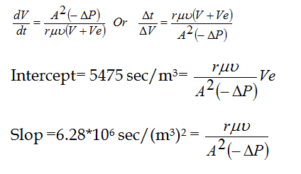
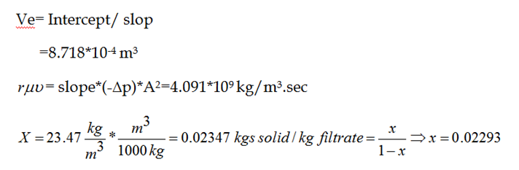

Slide 71
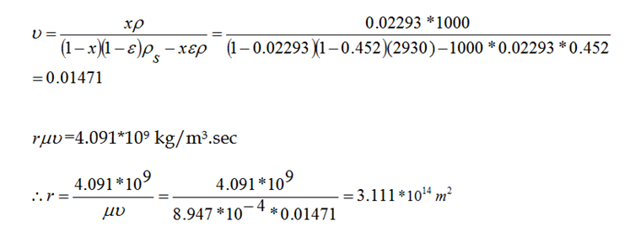

Slide 72
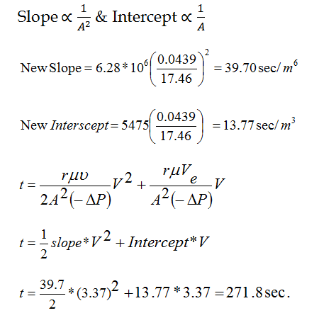
Example 6:-
Same slurry of example 5 is to be filtered in a plate and frame filter having 20 frames and 0.873 m² area per frame. The same pressure will be used in constant pressure filtration assuming the same filter properties of filter cake and bed. Calculate the time to recover 3.37 m³ filtrate?
Solution:-
In Ex.5, area= 0.0439 m², slope= 6.28 *106 sec/m⁶ and intercept is 5475 sm³. Since the filter cake properties is the same, slope can be corrected.
A=0.873*20=17.46 m²

Slide 73
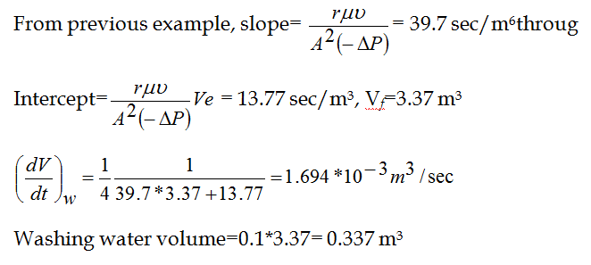
Example 7.
At the end of filtration cycle of example 6, a total filtrate volume of 3.37 m3 is collected in a total time of 271.8 sec. the cake is to be washed by through washing in a plate and frame pressure filter using a volume of water equal to 10% of the filtrate volume. Calculate the time of washing and total filter cycle time if cleaning filter take about 20 min?
Solution:-

Slide 74
Total filtration cycle is:-
[(271.8+198.9)/60]+20= 27.85 min.

Slide 75
H.W:-
(1) A leaf filter has an area of 0.5m2 and operates at a constant pressure
drop of 500 kPa. The following test results were obtained for a slurry
in water which gave rise to a filter cake regarded as incompressible:
Calculate:
(a) the time need to collect 0.8m3 of filtrate at a constant pressure drop of 700 kPa;
(b) the time required to wash the resulting cake with 0.3m3 of water at a pressure drop of 400 kPa.
Volume of filtrate collected (m³) | 0.1 | 0.2 | 0.3 | 0.4 | 0.5
Time (s) | 140 | 360 | 660 | 1040 | 1500

Slide 76
(2) Calculate:
(a) the time need to collect 0.8m3 of filtrate at a constant pressure drop of 700 kPa;
(b) the time required to wash the resulting cake with 0.3m3 of water at a pressure drop of 400 kPa.
Calculate:
(a) the time required to collect 1200 litre of filtrate at a constant pressure drop of 400 kPa with the same feed slurry;
(b) the time required to wash the resulting filter cake with 500 litre of water (same properties as the filtrate) at a pressure drop of 200 kPa.
[Answer: (a) 79:4 min; (b) 124 min.]
Volume of filtrate collected (litre) | 280 | 430 | 540 | 680 | 800
Time (min) | 10 | 20 | 30 | 45 | 60

